Slide 1

Artificial Intelligence: Product Recommendation System
This presentation details the development and analysis of an AI-based product recommendation system, designed to enhance user experience and drive sales within e-commerce platforms.

Slide 2


Introduction: The Power of AI in E-commerce
Artificial intelligence is rapidly transforming various sectors, including e-commerce, by enabling sophisticated data processing and decision-making. At its core, AI learns from data patterns to deliver tailored experiences. The concept, tracing back to ancient Greek philosophers and the Renaissance, has evolved significantly, moving from early symbolic AI to data-driven machine learning, as highlighted by Google researchers. This evolution underscores the "unreasonable effectiveness of data" in shaping modern AI applications.
An algorithm is a precise set of step-by-step instructions for solving a problem or completing a task. It must be clear, precise, and terminate after a finite number of steps.

Slide 3






Core AI Concepts for Product Recommendation
Artificial Intelligence (AI)
Machine Learning (ML)
Enables systems to perform tasks commonly associated with human intelligence, such as learning and decision-making without explicit programming.
A subset of AI focusing on building systems that learn and improve from data, crucial for pattern recognition in user interactions.
Collaborative Filtering
Content-Based Filtering
Recommends products based on the preferences of similar users or the similarity between items, leveraging collective behaviour.
Suggests products based on their features and a user's past preferences for similar item attributes.
Clustering (K-Means)
Similarity Measures
Groups similar users or products to identify distinct segments, aiding in targeted recommendations.
Techniques like cosine similarity quantify how alike two items or users are, forming the basis for recommendation scores.

Slide 4

Aim and Objectives: Crafting a Smart Recommender
The primary aim of this project is to construct an AI-based product recommendation system that delivers personalised suggestions by analysing user interests and past behaviour. This directly addresses the need for tailored interactions in modern e-commerce, where 56% of customers are more likely to return to sites offering recommendations, and 74% express frustration with non-personalised content.
Key Objectives:
To effectively collect, clean, and prepare product and user data for AI models.
To build a hybrid recommendation system integrating collaborative and content-based filtering.
To train, evaluate, and continuously improve the model for optimal accuracy and relevance.
To implement and test the system, demonstrating its applicability in real-world online retail.

Slide 5
Dataset: The Foundation of Our Recommendations
Our system utilises the "products" dataset by breadlicker45 from Hugging Face, a comprehensive collection of product-related data designed for machine learning tasks. This dataset provides rich metadata, including product names, descriptions, categories, prices, and review statistics, which are essential for both collaborative and content-based filtering approaches.
eac7efa5...
Hornby 2014 Catalogue
Hornby
£3.42
...
b17540ef...
FunkyBuys® Large Christmas Holiday Express
FunkyBuys
£16.99
...
348f3442...
CLASSIC TOY TRAIN SET TRACK CARRIAGES
ccf
£9.99
...
The dataset's tabular structure, comprising approximately 10,000 rows and 17 columns, is ideal for training models focused on product categorisation and enhancing recommendation accuracy.

Slide 6
Research Review: Advancements in Recommendation Systems
1
2
3
Collaborative Filtering Surveys (2025)
Deep Neural Networks in CF (2024)
Generative Recommender Systems (2025)
Examines how modern ML and DL address traditional CF challenges like data sparsity and cold-start problems.
Explores DNN architectures (MLPs, CNNs, RNNs, GNNs) for modelling complex, non-linear relationships in data to overcome CF limitations.
Introduces a paradigm shift towards GRS, integrating LLMs and VAEs to generate richer, contextualised recommendations beyond mere ranking.
4
5
Hybrid Recommendation Systems (2025)
Real-World Recommender Systems (2025)
Presents a practical case study of a hybrid system combining CF, content-based filtering (BM25), and price-similarity for revenue optimisation in e-commerce.
Highlights the gap between academic research and industrial reality, emphasising real-time performance, data scale, and business-driven objectives.

Slide 7
The Proposed Solution: A Hybrid Recommendation Architecture
Addressing Information Overload in E-commerce
The vast array of products available online often leads to customer decision fatigue and missed cross-selling opportunities for businesses. Our solution tackles this by implementing a robust hybrid recommendation system, designed to guide users to relevant products efficiently.
Key Stages:
Data Collection & Loading: Ingesting the comprehensive Amazon e-commerce dataset.
Data Preprocessing Pipeline: Cleaning text, normalising prices, and extracting relationships to prepare data for analysis.
Feature Engineering: Creating collaborative (co-purchase patterns) and content-based (product profiles) feature sets.
Dual Recommendation Engine: Employing both Item-Based Collaborative Filtering and TF-IDF Content-Based Filtering with Cosine Similarity.
Hybrid Recommendation Generation: Combining scores from both engines using a weighted linear approach for balanced, relevant suggestions.
Recommendation Delivery & Continuous Improvement: Sorting, filtering, and constantly refining the system based on performance metrics.

Slide 8

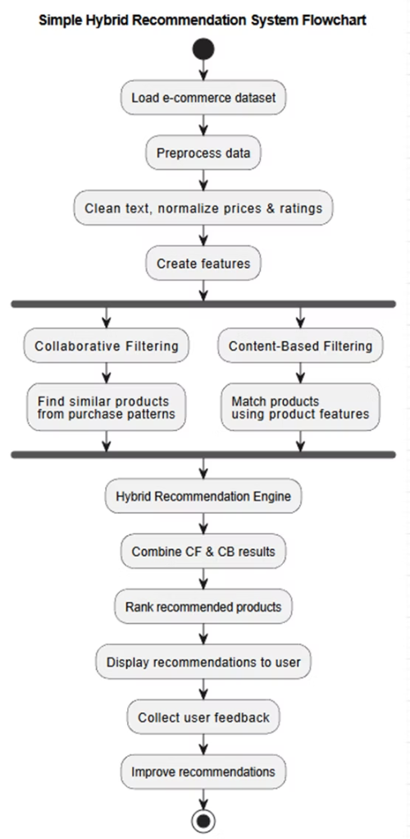
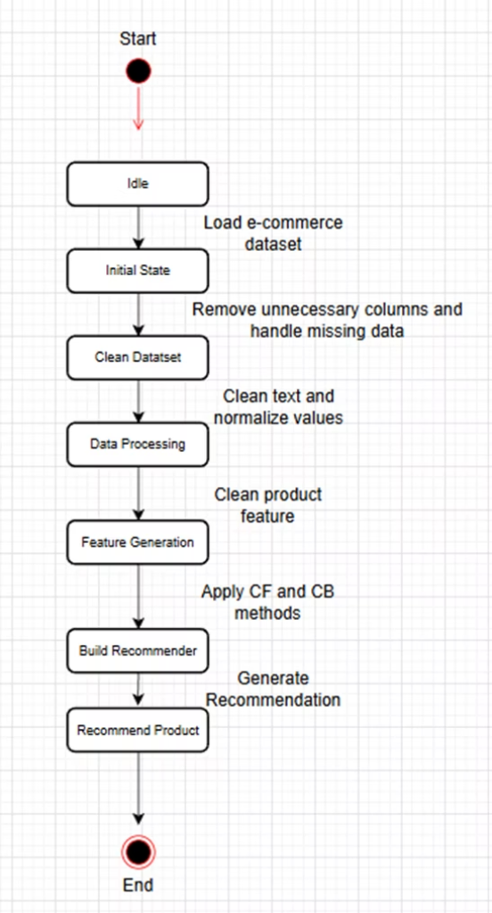
Pseudocode and Visualisation: System Logic
Pseudocode Overview:
Flowchart & State Transition Diagram:
IMPORT pandas, numpy, sklearn, re, math READ 'amazon_co-e-commerce_sample.csv' INTO data_frame DROP unnecessary columns DISPLAY cleaned data # Data Preprocessing CREATE function clean_text(text) APPLY clean_text to product details EXTRACT and NORMALIZE ratings and prices # Feature Extraction CREATE function extract_relationships(data) co_purchase_matrix = extract_relationships(data) CREATE function compute_collaborative_similarity(matrix) collab_similarity = compute_collaborative_similarity(...) # Content Features COMBINE product text features TRANSFORM text to TF-IDF vectors ENCODE categorical features CREATE function compute_content_similarity(feature_vectors) content_similarity = compute_content_similarity(...) # Hybrid Model CREATE hybrid similarity = α * collab_similarity + (1-α) * content_similarity TRAIN and SAVE model # Recommendation Function DEFINE function get_recommendations(product_name, top_n) FIND product, get index EXTRACT similarity scores from hybrid matrix SORT and RETURN top_n products
The flowchart illustrates the sequential steps from data loading and preprocessing through to the dual filtering engines and hybrid combination, culminating in recommended product display and user feedback collection for continuous improvement.
The state transition diagram depicts the system's operational states, from initial idle to clean dataset, data processing, feature generation, recommender building, and product recommendation.

Slide 9
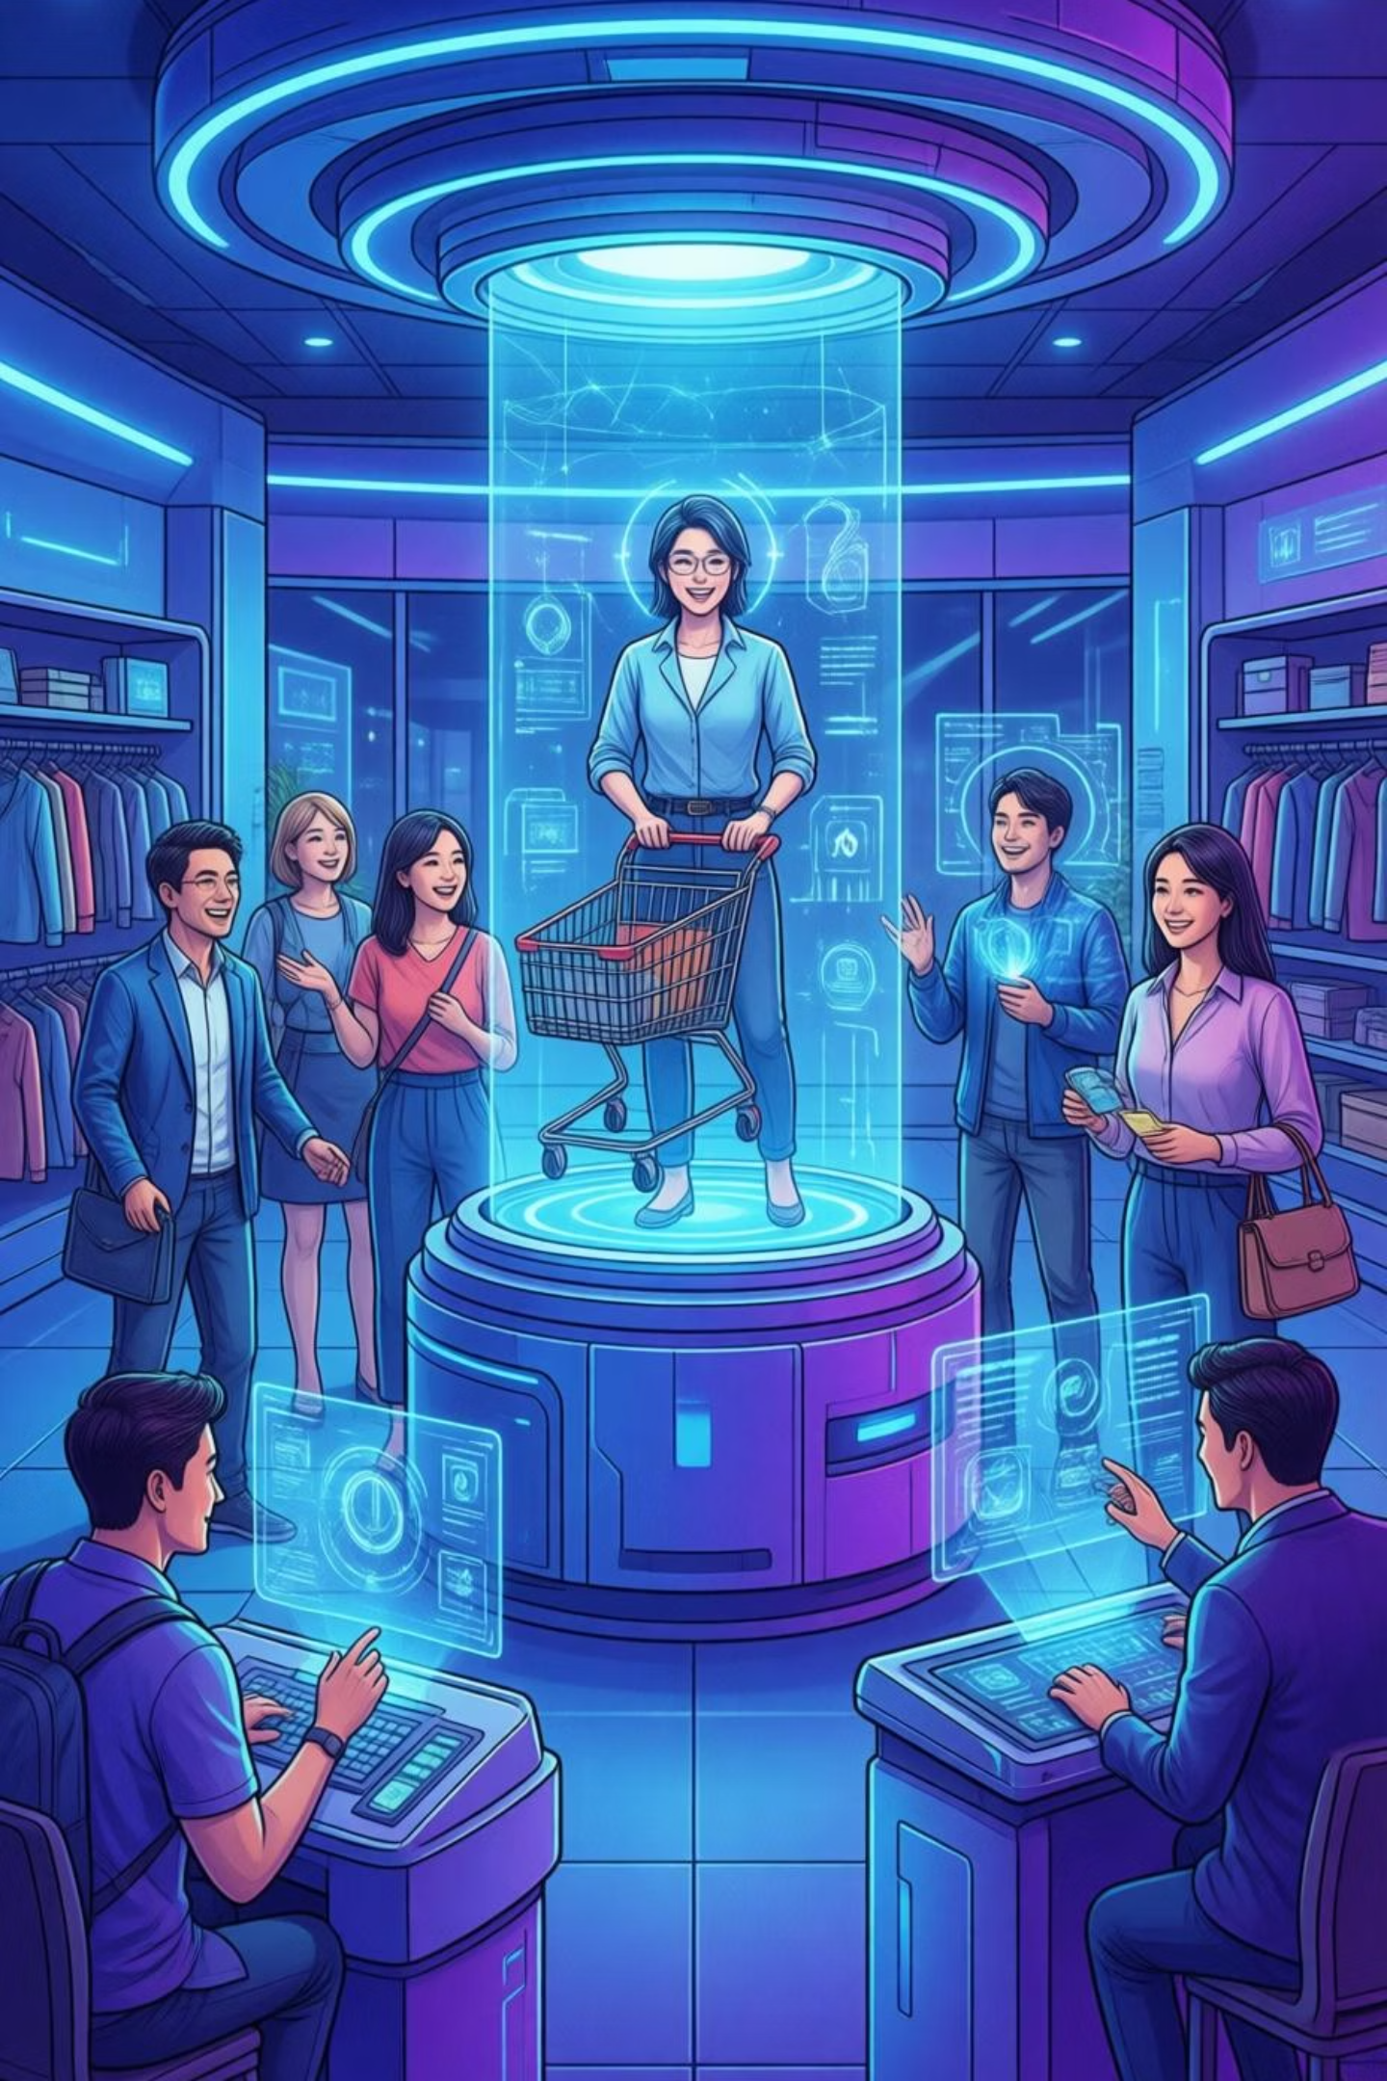
Conclusion: Solving Real-World Problems and Future Work
Analysis of Work Done
Addressing Real-World Problems
Comprehensive research, from journal reviews to existing e-commerce platform analysis, informed the design. The proposed solution's algorithms were clearly articulated, supported by pseudocode and diagrammatic representations.
Our system combats information overload by providing personalised product recommendations, directly enhancing user experience and boosting business conversion rates, much like successful implementations by Amazon.
Future Enhancements
Exploring advanced ML/DL techniques (matrix factorisation, neural CF).
Developing interactive user interfaces with real-time feedback and explainable recommendations.
Ensuring data privacy, security, and ethical AI use.

